Slide 1
Community of Practice: Operational Report Workbook (ORW) Template
Alejandra Johnson, CMS TD
Carol Hefling, Chi Chau and Samuel Sowah, Kentucky Medicaid
Emily Armstrong, MITRE Metrics Team
April 29, 2026
For Internal Use Only

Slide 2
Agenda
Regulatory Drivers for Operational Reporting
ORW Overview and Reporting Process
ORW: Best Practices
FAQs
Notes:
AJ

Slide 3
Key Objectives
After this Community of Practice event, participants will:
✓
Understand the data fields and formatting requirements in the OMB-approved Operational Report Workbook (ORW) template
✓
Be knowledgeable about the outcomes and metric data reporting required for MES IT systems to remain eligible for enhanced federal funding for M&O
✓
Be prepared to adopt and adapt to the new ORW template for operational reporting no later than July 01, 2026
Notes:
AJ

Slide 4
Regulatory Requirements for Operational Reporting
Summary
To be eligible to receive enhanced federal matching for MES expenditures:
States must produce data, reports, and performance information from their MES modules
The data produced must support evaluation and continuous improvement of business operations
The information must promote transparency and accountability
Policy References
42 C.F.R. §433.112(b)(15): Produce transaction data, reports, and performance information that would contribute to program evaluation, continuous improvement in business operations, and transparency and accountability.
42 C.F.R. §433.116(b): CMS will approve enhanced FFP for system operations if the conditions specified in paragraphs (c) through (i) of this section are met.
42 C.F.R. §433.112(c): The conditions of §433.112(b)(1) through (22) must be met at the time of approval.
42 C.F.R. §433.116(i): The standards and conditions of §433.116(b)-(j) including conditions of §433.112(b)(1) through (22) of this subpart must be met.
Notes:
AJ

Slide 5
Operational Report Workbook (ORW) Template Overview
The Operational Report Workbook (ORW) is an OMB-approved Excel template to streamline state Operational Reporting of systems performance data [SHO #25-003]
Captures key data elements: Collects required state data (e.g., Outcomes, Metric IDs, Metric Definitions, Metric Values, etc.)
Structures data submission: Provides a consistent format for metric and data submission (including dropdowns for certain fields and “recall” of Metric IDs for ease and accuracy of reporting)
NEW “CMS Attestations” tab: Requires states to attest to CMS-required outcomes and conditions for enhanced funding as reported in each system's APD/OAPD and provide justification for those that are not applicable.
Required as of July 01, 2026
The ORW can be accessed via Medicaid.gov and the MES Certification Repository on GitHub
Notes:
AJ

Slide 6
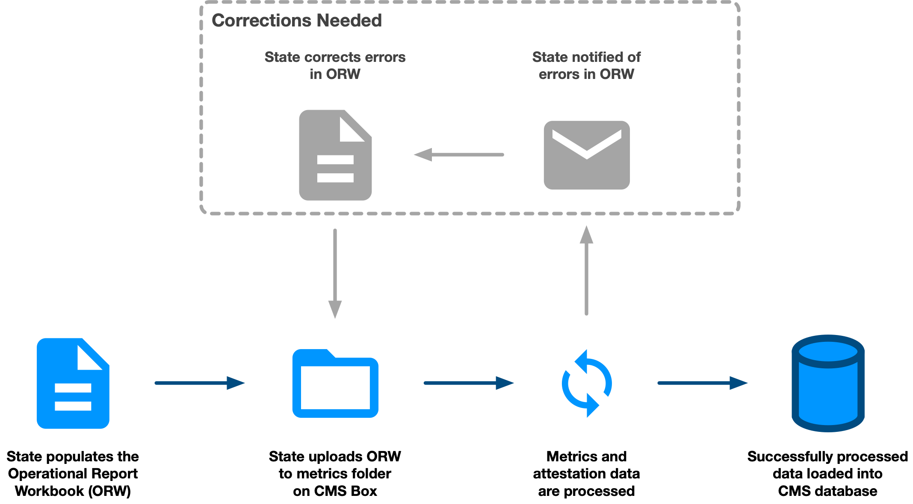
Operational Report Workbook (ORW) Process Flow
Notes:
Emily
Overview of the path of the ORW from creation through processing to database ingestion
SO involvement as state populates ORW with the outcomes and metrics included in the APD for the system, which is the gold source. SO should crosscheck the list of CMS-required outcomes the state attests to on the CMS Attestation tab against the list in the APD.
SO also provides state access to the correct file repository on Box. Note that there will be a migration to the new “Accounts” location, which will be transparent when the move happens. For now, states should continue to upload files to the same Metrics folder on Box.
ORW will likely lead to improved processing times

Slide 7
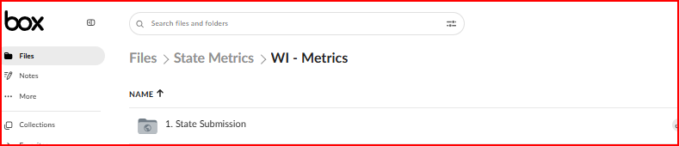
Operational Report Workbook Upload

Slide 8

ORW: Live Demo
Highlights:
New CMS “Attestations” tab
Reporting the new CEF metric
New data collection fields
Error reduction measures
Auto-populated drop downs
Locked content
Notes:
Emily

Slide 9
Focus: CMS Attestations Tab
Key details to remember when populating the new "CMS Attestations" tab:
A state must attest to every CMS-required outcome for a module even if only reporting on a subset of outcomes.
For example, if a state is reporting on an DSS/DW system and includes a PI outcome as part of that system, then the state must attest to all of the DSS/DW outcomes AND all of the PI outcomes.
One set of 22 CEF attestations per system.
Attesting to CEFs multiple times will not affect processing, but it is unnecessary.
Do not delete rows and columns.
Notes:
Emily

Slide 10

CMS Operational Workbook – Best Practices And TIPS
Start ORW development early – Don’t wait until ORR; involve the state Certification Team during APD planning.
Make outcomes measurable – Focus on performance and impact, not just volume.
Create a metric dictionary/mapping – Include definitions, formulas, business/technical owners, and data sources.
Ensure data traceability and reproducibility – Be able to track outcomes from reports back to source systems and raw data.
Define 12-month rolling periods clearly – Align with APD submission timelines.
Leverage automation tools to reduce manual errors
Mirror CMS Box structure in SharePoint
Engage CMS early and often – Share drafts, gather feedback, and collaborate proactively.
Continuously improve processes based on past performance and feedback
Questions/Comments for Kentucky: Carol.Hefling@ky.gov, chi.chau@ky.gov, or samuel.sowah@ky.gov

Slide 11
Contact Information
Submit questions related to Operational Reporting to:
Alejandra Johnson
alejandra.johnson@cms.hhs.gov
Metrics Team
MES_OperationalReporting@cms.hhs.gov

Slide 12
Resources
Operational Requirements ​
SMD# 22-001, released in April 2022, and ​
The May 24, 2023, CMCS Informational Bulletin (CIB)​
SHO#25-003, released August 6, 2025​
​
Templates​
MES Templates on Medicaid.gov and ​
GitHub | CMS MES Certification Repository​
​
References​
Overview of Operational Reporting
Module Abbreviations

Slide 13

Questions

Slide 14
FAQs (1 of 4)
Since my state’s reporting team has been using the current version of the ORW, do they need to change over to the new ORW template for continued reporting?
Yes. Following the SHO release, the new ORW template will be required for all operational reports beginning July 1, 2026.
Previously, states uploaded their operational metrics to the 1. State Submission folder on Box. Has this process changed?
No. Until instructed otherwise, states should upload all operational metric reports to the state metrics folder on Box, in subfolder 1. State Submission.
State Officers can provide “Viewer Uploader” access to members of the state team who need access to Box, using the individual’s email address.
Is there a file naming convention for operational reports? Where can I find this?
The file naming convention is
"Operational_Report_[state abbreviation]_[module abbreviation]_[YYYY-MM-DD]"
Refer to the Intake Procedures Manual on the “Metrics and Ongoing Reporting” page of the MES Certification Repository (GitHub) for more information.

Slide 15
FAQs (2 of 4)
If a state is unable to report on a metric that is listed in their annual OAPD, should they still include it in the ORW in which they submit their other metrics?
The State Officer should follow up with the state for any missing metrics and approve the state’s justification. Then, the state should include the metric details on the Metric Definition tab only and include the justification in the “Note” column.
If a state has already submitted operational report metrics and then has an update to one or some of the data, should they submit another ORW in the same reporting time frame?
If the state wants to update previously submitted data, they should change the file name to reflect the new submission date and upload to Box with the updated information. The newer data will overwrite previous submissions of the same Metric IDs for the same Reporting Date in the database.
Please differentiate between the 6-month and 12-month reporting requirements.
States are required to collect 6 months of metric data to prepare for a certification review and 12 months of data to be included in an OAPD submission, unless the OAPD is submitted less than 12 months after certification.

Slide 16
FAQs (3 of 4)
Is the CEF metric an attestation-type metric?
No. States are required to capture the three separate counts of “Very High”, “High”, and “Total Count” of open security findings per its POA&M and submit these quarterly in the ORW.
Will there be a cheat sheet to provide guidance on template completion for challenging or unique state metrics?
The ORW template contains instructions for what is required in each column.
In addition, there are several resources identified at the end of this presentation.
The Metrics team has developed a Quick Reference Guide on how to complete the ORW template and State Officers should request technical assistance if/as needed.
What is the timeline to implement the ORW?
CMS is allowing a runway of several months for states to adapt and adopt the updated ORW.
All states must be using the new OMB-approved ORW template by July 01, 2026.

Slide 17
FAQs (4 of 4)
What should states include as a benchmark for each metric? Please provide an example of how a benchmark relates to a metric.
States are encouraged to set benchmarks for their metrics to establish a goal for their system’s performance. Currently, this is an optional field in the ORW template, but states can and should consider setting realistic quality and/or system performance goals (“benchmarks”) to evaluate their IT systems’ achievements.
States identify metrics for each IT system to show whether they are achieving desired outcomes.
A benchmark is the target value the state wants to reach for a metric, based on ongoing measurement and evaluation.
For example, a state might identify a metric that measures the percentage of auto-assignment its system does for its Medicaid enrollees and identify that it wants to reach a benchmark of 100% assignment (measured monthly).

